Slide 1


Slide 2
Agenda
Spring Framework
Spring Boot
Advantages
Some Annotations
Spring Container
Design Patterns (used by Spring)
Definition
Dependency Injection
Other Design Patterns

Slide 3
Spring Framework
It is an open-source Java platform that provides comprehensive infrastructure support for developing robust Java applications very easily and quickly.
Spring is the most popular application development framework for enterprise Java software.
We can use the Spring Framework core features in developing any Java application. Also, there are extensions for building web applications on top of the Java EE platform.
Spring framework aims to make Java EE development straightforward and promote good programming practices by enabling a POJO-based programming model.

Slide 4
Spring Framework
It comprises several modules such as Spring Security, Spring Data, Spring Batch, Spring AOP, Spring MVC, to mention a few of them.
We, as software developers, may come across common problems in our coding projects. Spring modules solve these by using design patterns and the best practices available in the market. Spring also allows us to choose just the modules that our project needs.
It was initially written by Rod Johnson and was first released under the Apache 2.0 license in June 2003 (Gang of Four Book)

Slide 5
Spring Boot
Spring Boot is a Spring module that provides the RAD (Rapid Application Development) feature to the Spring framework.
It is used to create a stand-alone spring-based application that you can just run because it needs minimal spring configuration.
It uses convention over configuration software design paradigm used by software frameworks that attempts to decrease the number of decisions that a developer is required to make without necessarily losing flexibility. This means a developer only needs to specify unconventional aspects of the application. For example, if there is a class Sales in the model, the corresponding table in the database is called "sales" by default. It is only if one deviates from this convention, such as the table "product sales", that one needs to write code regarding these names.

Slide 6
Spring Boot Advantages
Stand-alone Spring applications can be started using java -jar.
Embed Tomcat, Jetty or Undertow. You don't need to deploy WAR files.
It provides opinionated 'starter' POMs to simplify your Maven or Gradle configuration. Opinionated means it comes with a default configuration that you can override. Spring's opinion that it's a good starting point.
It provides production-ready features such as metrics, health checks and externalized configuration. The spring-boot-actuator module provides all of Spring Boot’s production-ready features.
Absolutely no code generation and no requirement for XML configuration.

Slide 7
SpringBootApplication Annotation
It is one of the essential annotations from the Spring Boot Module.
This annotation combines the following three Spring annotations and provides all three functionalities in just one code line.
@Configuration - This annotation marks a class as a configuration class for java-based configuration. This is particularly important if you favour java-based configuration over XML configuration.
@ComponentScan - This annotation enables component-scanning so that the web controller classes and other components you create will be automatically discovered and registered as beans in Spring's Application Context. This annotation finds all the @Component, @Controller, @Service and @Repository classes.

Slide 8
SpringBootApplication Annotation
@EnableAutoConfiguration - This annotation enables the magical auto-configuration feature of Spring Boot, which can automatically configure a lot of stuff for you. For example, when writing a Spring MVC application that has the Thymeleaf JAR files on the application classpath, Spring Boot auto-configuration can configure the Thymeleaf template resolver, view resolver, and other Thymeleaf settings automatically.
Notes:
AutoConfiguration spring-boot-autoconfigure-2.2.1.RELEASE-sources.jar

Slide 9
Spring XML Configuration
<?xml version="1.0" encoding="UTF-8"?>
<beans xmlns="http://www.springframework.org/schema/beans"
xmlns:xsi="http://www.w3.org/2001/XMLSchema-instance"
xmlns:context="http://www.springframework.org/schema/context"
xmlns:mvc="http://www.springframework.org/schema/mvc"
xsi:schemaLocation="http://www.springframework.org/schema/beans
http://www.springframework.org/schema/beans/spring-beans-3.0.xsd
http://www.springframework.org/schema/mvc
http://www.springframework.org/schema/mvc/spring-mvc-3.0.xsd
http://www.springframework.org/schema/context
http://www.springframework.org/schema/context/spring-context-3.1.xsd">
<mvc:annotation-driven/>
<mvc:default-servlet-handler/>
<mvc:resources mapping="/resources/**" location="/resources/"/>
<context:component-scan base-package="com.busyqa.course"/>
<bean id="springTemplateResolver" class="org.thymeleaf.spring5.templateresolver.SpringResourceTemplateResolver">
<property name="prefix" value="/WEB-INF/pages/"/>
<property name="suffix" value=".html"/>
<property name="templateMode" value="HTML5"/>
</bean>
<bean id="templateEngine" class="org.thymeleaf.spring5.SpringTemplateEngine">
<property name="templateResolver" ref="templateResolver" />
</bean>
<bean class="org.thymeleaf.spring5.view.ThymeleafViewResolver">
<property name="templateEngine" ref="templateEngine"/>
</bean>
<!-- declare datasource bean -->
<bean id="dataSource" class="org.springframework.jdbc.datasource.DriverManagerDataSource">
<property name="driverClassName" value="com.mysql.jdbc.Driver"/>
<property name="url" value="jdbc:mysql://localhost:3306/testdb"/>
<property name="username" value="root"/>
<property name="password" value="root"/>
</bean>
</beans>

Slide 10
Design Principles
Design principles provide high level guidelines to design better software applications.
They do not provide implementation guidelines and are not bound to any programming language.
Examples: IoC Principle
Notes:
https://www.tutorialsteacher.com/articles/difference-between-design-principle-and-design-pattern
https://www.tutorialsteacher.com/ioc/introduction

Slide 11
IoC Principle
Inversion of Control, or IoC for short, is a design principle that recommends the inversion of different kinds of controls in object-oriented design to achieve loose coupling between application classes.
In this case, control refers to any additional responsibilities a class has, other than its primary responsibility, such as control over the flow of an application or control over the dependent object creation and binding (Remember SRP - Single Responsibility Principle)

Slide 12
Design Patterns
Design patterns provides low-level solutions related to implementation, of commonly occurring object-oriented problems. In other words, design patterns suggest a specific implementation for the specific object-oriented programming problem.
These solutions were obtained by trial and error by numerous software developers over quite a substantial period of time, and represent the best practices used by experienced object-oriented software developers.
For example, if you want to create a class that can only have one object at a time, then you can use the Singleton design pattern which suggests the best way to create a class that can only have one object.

Slide 13
Dependency Injection
Dependency Injection (DI) is a design pattern that implements the IoC principle to invert the creation of dependent objects.
It allows the creation of dependent objects outside of a class and provides those objects to a class through different ways. Using DI, we move the creation and binding of the dependent objects outside of the class that depends on them.
It involves 3 types of classes.
Client Class (dependent): is a class that depends on the service class.
Service Class (dependency): it provides a service to the client class.
Injector Class: injects the service class object into the client class.

Slide 14
Other Design Patterns
Spring Framework uses many design patterns. We benefit from them even without noticing it by using Spring and its modules in our projects.
Among them and just to mention a few we have:
Singleton
Factory
Proxy
Model View Controller (MVC)
Front Controller

Slide 15
Spring IoC Container
It is a framework used to manage automatic dependency injection throughout the application so that we, as programmers, do not need to put in more time.
The Spring container uses the dependency injection pattern (DI) to control the components that make up an application. These objects are called Spring Beans.
The container gets instructions on what objects to instantiate, configure, and assemble by reading the configuration metadata provided. The configuration metadata can be represented by XML, Java annotations, or Java code.

Slide 16
Agenda
Model View Controller (MVC)
Three Layer Architecture
Other Design Patterns used in Spring.
Application Service
Data Access Object (DAO)
Spring MVC
Definition
Request Processing
More annotations

Slide 17
Model View Controller (MVC)
It is a design pattern used to divide the user interface of an application into layers. So each layer could be modified independently from the other layers in a straightforward fashion.
The MVC design pattern is made of three parts:
Model: Contains only the pure data, it contains no logic describing how to present the data to a user. The models can have multiple views associated.
View: Presents the model’s data to the user. The view knows how to access the model’s data, but it does not know what this data means.
Controller: Exists between the view and the model and controls the data flow into model object and updates the view whenever data changes. Decides which business module is going to take care of the user request. It receives and validates the inputs, but the business logic .

Slide 18
Three Layer Architecture
It is a well-established software application architecture that organizes applications into three logical layers.
Presentation Layer - It is where the user interacts with the application. Its primary purpose is to display and collect information from the user. We use the MVC design pattern to organize this layer. It should be as thin as possible and limited to the MVC operations. The MVC Controllers can receive and validate the inputs, manipulate the model object, and pass the appropriate model to the View. Still, the service layer should do all the business-related operations.

Slide 19
Three Layer Architecture
Service Layer - It’s also known as the business logic layer. As the heart of the application, it processes the information collected in the presentation layer. For example, this layer performs calculations, data transformations, processes, and validations (business rules).
Data Layer - It’s responsibility is limited to create, retrieve, update, and delete data (CRUD operations) on a data source, which is usually a relational or non-relational database. The data access object (DAO) design pattern is used in this layer.
Note.- Layer is often used interchangeably, and mistakenly, for tier. They aren't the same. A layer refers to a functional division of the software, but a tier refers to a functional division of the software that runs on infrastructure separate from the other divisions. The Contacts app on your phone, for example, is a three-layer application, but a single-tier application, because all three layers run on your phone.

Slide 20
Application Service
It reduces the coupling between the user interface and the persistence components by having a layer of Service components where the application's business logic is concentrated.

Slide 21
Data Access Objects (DAO)
It encapsulates all the access to the source of data.
The source of data could be a Database, Files, Web Services, any data repository.
It help us to have all data access in one place in our projects.

Slide 22
Spring MVC
Spring Framework has its own MVC module that implements the MVC design pattern.
The main component of this Spring module is the DispatcherServlet. It’s in charge of handling the user HTTP requests and sending them to the appropriate Controller.
It can be integrated with templating technologies such as Thymeleaf, Velocity, Freemarker, among others.

Slide 23
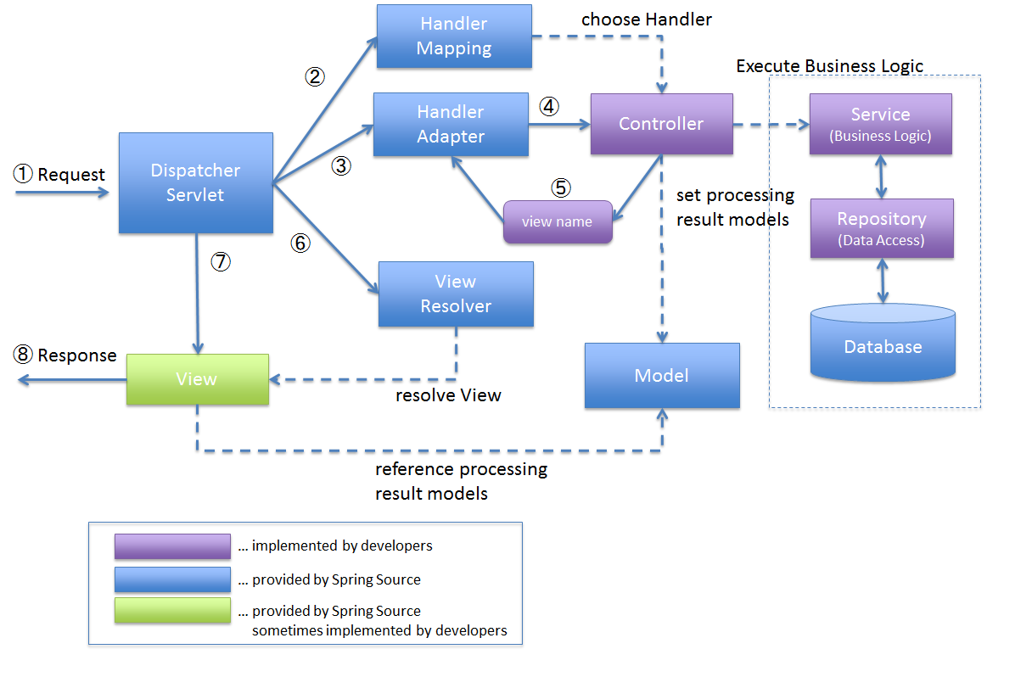
Spring MVC

Slide 24
More Annotations
@Component: It marks a Java class as a bean, so Spring's component-scanning mechanism can pick it up and pull it into the application context.
@Repository: This is a specialization of the @Component annotation with similar use and functionality. In addition to importing the DAOs into the DI container, it also makes the unchecked exceptions (thrown from DAO methods) eligible for translation into Spring DataAccessException.
@Service: This is also a specialization of the @Component annotation. It doesn't currently provide any other behaviour over the @Component annotation, but it's a good idea to use @Service over @Component in service-layer classes to specify the intent better.
@Controller: This, too, is a @Component specialization. It provides access to the business logic of the application.

Slide 25
More Annotations
@RequestMapping: It is used to configure the mapping of web requests.
@RequestParam: It is used with @RequestMapping to bind a web request parameter to the handler method's parameter. It has some shortcut annotations like @GetMapping and @PostMapping.
@ModelAttribute: It is an annotation that binds a method parameter or method return value to a named model attribute and then exposes it to a web view.
@Autowired: It allows Spring to resolve and inject collaborating beans into your bean.

Slide 26
Agenda
Database Model Types
Relational and Non-relational Databases
Database Hosting Types
On-premises and Cloud Databases
Java Persistence
What is JDBC?
What is ORM?
What is JPA?
Spring Data JPA
Definition
Repositories
Query Creation

Slide 27
Databases
Databases are an organized collection of related data records. The database management systems manage and manipulate information inside a database.
There are many different approaches to storing and modelling data, resulting in various databases types.

Slide 28
Database Types
Based On | Database Types
Model | Relational Non-Relational (NoSQL) Object-oriented
Location | Centralized Distributed
Design | Operational (OLTP) Analytical (OLAP)
Hosting | On-Premises Cloud
Processing Power | Personal Commercial
Notes:
https://phoenixnap.com/kb/database-types

Slide 29
Database Model Types
The three general database types based on the model are:
Relational database
Non-relational database (NoSQL)
Object-oriented database
The difference between the models is how the information looks inside the database. Consequently, each model type has a different management system and data relationships.

Slide 30
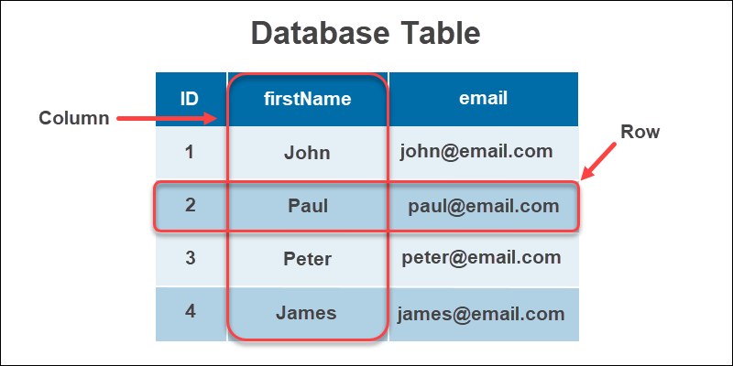
Relational Databases
The relational database model is the most extensively used and the oldest database type. The three critical components of a relational DB are:
Tables. An entity type with relations.
Rows. Records or instances of an entity type.
Columns. Value attributes of instances.

Slide 31
Relational Databases
The main features of a relational database are:
The database retains integrity while performing transactions (ACID).
Provides the capability to store any data and run complex queries.
The relational databases are the most implemented database type mainly used for Online transaction systems. The database supports many users and frequent queries needed in online transactions.
The most popular relational databases are:
Oracle
MySQL
Microsoft SQL Server
Postgre SQL
IBM DB2
SQLite
Microsoft Access
MariaDB

Slide 32
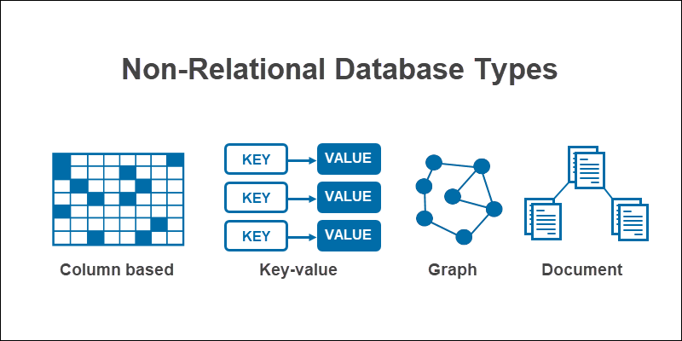
Non-Relational Databases
A non-relational database, or NoSQL ("Not Only SQL"), is a type of database that models and stores data differently from relational databases. Instead of tables, non-relational databases model relationships between data alternatively.
The 4 NoSQL database:
Column based
Key-value
Graph
Document

Slide 33
Non-Relational Databases
The main features of a non-relational database are:
Flexible: Handling structured, semi-structured, and unstructured data is a breeze with non-relational database types.
Scalable and responsive: Massive data storage scales well with on-demand servers and provides quick query responses.
The non-relational databases perform best with variable data structures and massive amounts of data.
The most popular non-relational databases are:
MongoDB
Redis
Cassandra
Neo4J
HBase
Oracle NoSQL
RavenDB

Slide 34
Database Hosting Types
The two database types based on the hosting are:
On-premises databases
Cloud databases
On-premises databases reside in-house. All the software, infrastructure and administration needed for support is local.
The main on-premises database features are:
Security. Due to the in-house infrastructure, on-premises databases are the best solution for storing sensitive information.
Control. The enterprise is in complete control over the available information, providing a high level of regulation and privacy over the data.

Slide 35
Database Hosting Types
A cloud database is a hosting solution given by a third-party provider. The pay-as-go solution provides the database-as-a-service, avoiding setting up a data center physically. The agile approach minimizes the initial investments needed to acquire data space while quickly expanding as more resources are required.
The leading cloud database features are:
Scalability. Cloud databases are flexible. Increasing or decreasing resources is quick due to virtualization.
Cost. With a cloud database, you only pay for what you need. The cost of investing in technical staff, as well as maintenance, is minimized.
Examples: Amazon AWS, Google Cloud, IBM Bluemix, Cloud Foundry (Pivotal).

Slide 36
Java Database Connectivity (JDBC)
Java Database Connectivity (JDBC) is an application program interface (API) packaged with the Java SE edition that makes it possible to standardize and simplify the process of connecting Java applications to external relational database management systems (RDBMS).
Fundamentally, applications written in Java perform logic. For example, the Java language provides iterative logic with loops, conditional logic with if statements and object-oriented analysis through classes and interfaces but do not store data persistently.

Slide 37
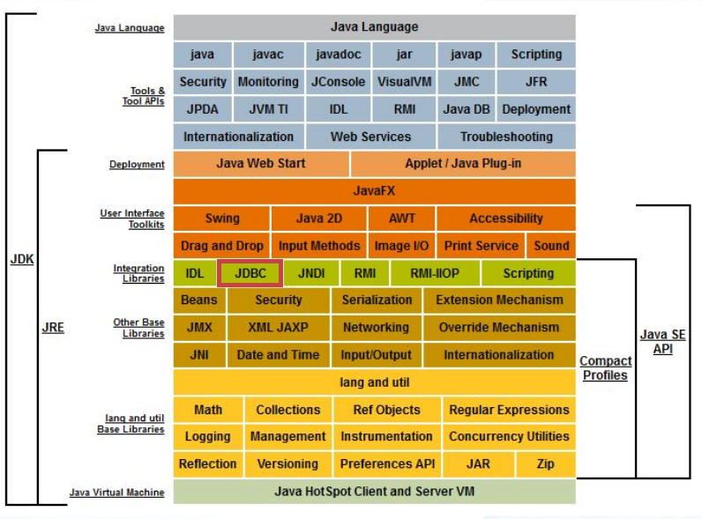
Java SE - JDBC

Slide 38
SQL - JDBC
Structured Query Language (SQL) is an ISO specification that defines how applications can query, create, update, and delete information. Generally speaking, it defines how to interact with a relational database.
The goal of the JDBC API is to provide a connection to a relational database that allows the execution of SQL statements. The results from those SQL statements can be processed within a Java program.
JDBC is a connectivity API. SQL remains the language used to actually talk to the database.

Slide 39
Criticisms of JDBC
JDBC is often criticized for burdening the developer by writing a significant amount of boilerplate code to perform a basic operation.
In addition to this, interactions with the JDBC API throw many potential exceptions that must be handled. However, there is very little a developer can do when these JDBC errors occur.
As a result, operations that might require only a few code lines in other languages can be five or six times in length when performing the same database operation in Java.

Slide 40
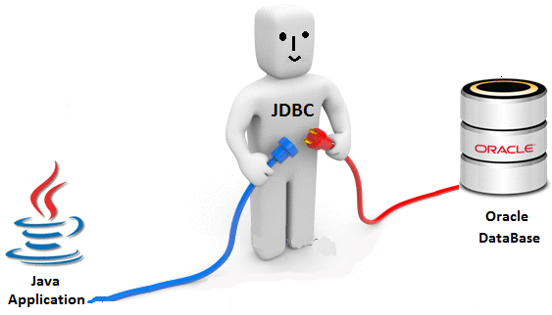
JDBC

Slide 41
Object Relational Mapping (ORM)
The philosophies behind object-oriented development and relational database systems are very different, which often leads to discussions about the object-relational mismatch.
Object-oriented systems are designed much differently than relational systems, and pulling data from a relational database and bringing that data into an object-oriented system is not a straightforward process.
The goal of the JDBC API is to define classes, methods and interfaces that minimize the mismatch and make it easier to marshal data back and forth between a Java program and an external database. But JDBC efforts are not sufficient.

Slide 42
Object Relational Mapping (ORM)
To help address the object-relational mismatch, several frameworks exist that simplify moving data between a relational database and a Java program.
Popular object-relational mapping (ORM) frameworks include Hibernate, TopLink and DataNucleus.
While each framework has its unique capabilities, they all comply with the Java Persistence API standard, JPA for short, which is now part of the Java EE/Jakarta EE specification.

Slide 43
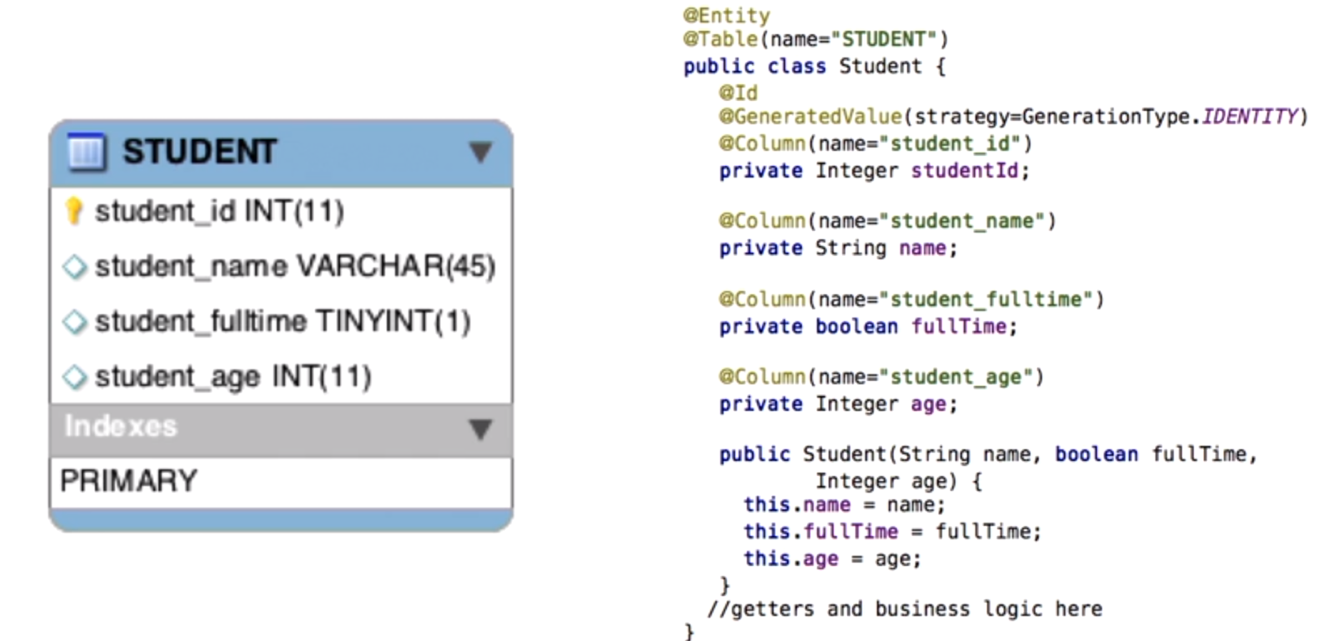
Object Relational Mapping (ORM)

Slide 44
Java Persistence API (JPA)
JPA is the standard specification for ORM in Java EE.
Hibernate is a framework that implements that specification. You can use the standard JPA APIs and configure your application to use Hibernate as the specification provider under the covers.
It helps reduce the burden of writing codes for relational object management. The programmer follows the ‘JPA Provider’ framework, allowing easy interaction with the database instance.

Slide 45
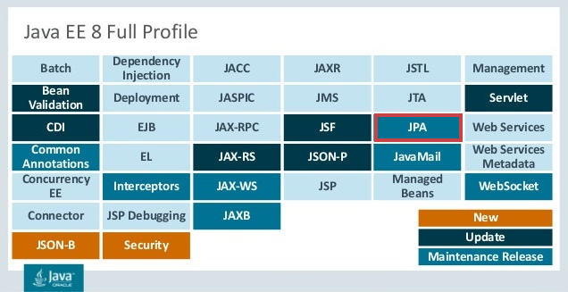
Java EE - JPA

Slide 46
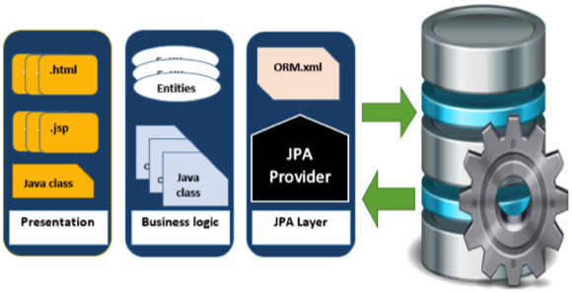
Java Persistence API (JPA)

Slide 47
Spring Data JPA
Spring Data JPA is not a JPA provider.
It is a library/framework that adds an extra layer of abstraction on the top of our JPA provider.
It supports creating JPA repositories by extending the Spring Data repository interfaces.
Spring Data Common provides the infrastructure shared by the data store-specific Spring Data projects.

Slide 48
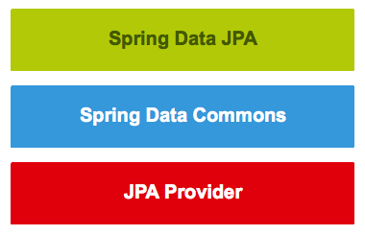
Spring Data JPA

Slide 49
Spring Data JPA Repositories
A JPA Repository class defines the operations that we can execute on a Database.
Spring Data JPA comes out of the box with JPA Repositories that we can extend and customize for our project’s needs.
Spring Data generates SQL code based on the definitions of the operations in the Repositories. We can continually create our SQL code for complex operations that are hard to define in the Repositories.
Spring Data Commons project provides interfaces such as:
Repository<T, ID extends Serializable>
CrudRepository<T, ID extends Serializable>
JpaRepository<T, ID extends Serializable>
Notes:
https://docs.spring.io/spring-data/commons/docs/current/api/org/springframework/data/repository/CrudRepository.html https://docs.spring.io/spring-data/jpa/docs/current/api/org/springframework/data/jpa/repository/JpaRepository.html

Slide 50
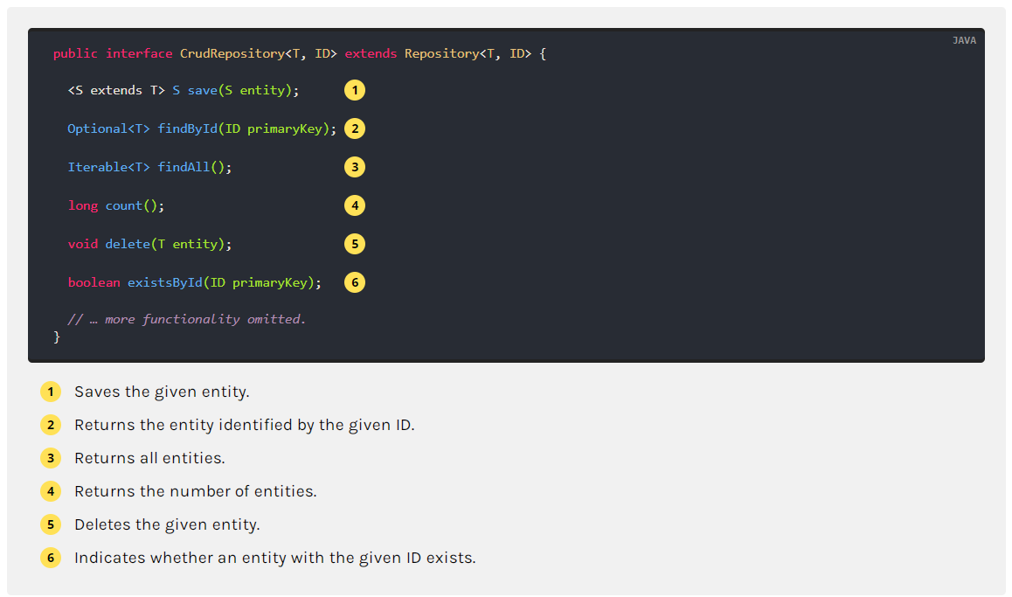
Spring Data JPA Repositories

Slide 51
Spring Data JPA Query Creation
The query builder mechanism built into Spring Data repository infrastructure is useful for building constraining queries over entities of the repository.
The mechanism strips the prefixes find…By, read…By, query…By, count…By, and get…By from the method and starts parsing the rest of it.
The introducing clause can contain further expressions, such as a Distinct to set a distinct flag on the query to be created.
However, the first By acts as a delimiter to indicate the start of the actual criteria. At a fundamental level, you can define conditions on entity properties and concatenate them with “And” and “Or”.

Slide 52
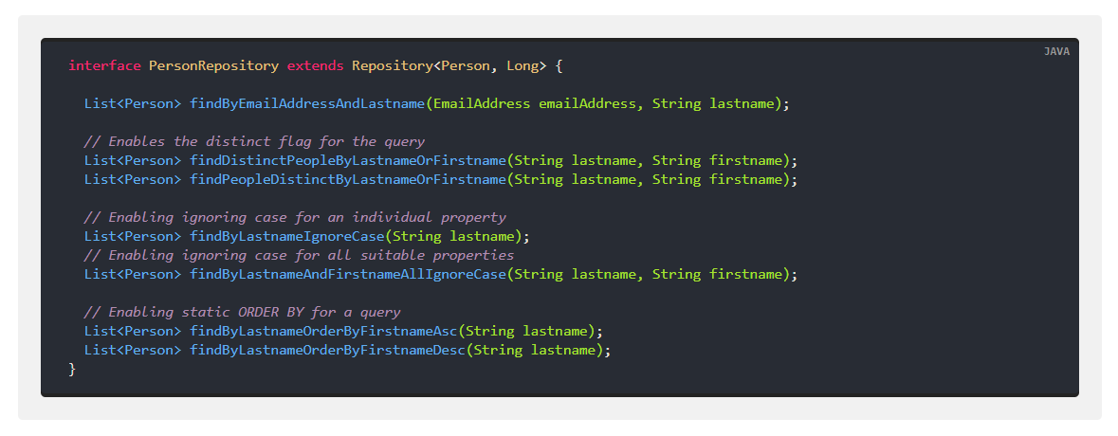
Spring Data JPA Query Creation

Slide 53
Spring Data JPA Documentation
Spring Data JPA - Reference Documentation

Slide 54
Agenda
What is AOP?
AOP Terminology
Spring AOP Definition

Slide 55
Aspect Oriented Programming
AOP stands for Aspect-Oriented Programming.
AOP is a programming paradigm that aims to increase modularity by separating cross-cutting concerns.
During software development, functions that span multiple points of an application are called cross-cutting concerns. These cross-cutting concerns differ from the applications’ main business logic. Hence, separating these cross-cutting concerns from the business logic is where aspect-oriented programming (AOP) comes into the picture.
Using AOP, we define the standard functionality in one place. Still, we can determine how and where this functionality is applied without modifying the class to which we are using the new feature. We can now modularize cross-cutting concerns into special classes called aspects.
AOP offers mainly two benefits. First, each concern’s logic is now in one place instead of being scattered all over the codebase. Second, our business modules are cleaner since they only contain code for their primary concern, and secondary concerns have been moved to aspects.

Slide 56
AOP Terminology
Pointcut: It is the expression that defines what method’s calls should be intercepted. For example:
execution(* com.busyqa.course.service.UserService.*(..))
Advice: It is the logic that you want to invoke when you intercept a method.
Aspect: The combination of defining when you want to intercept a method call (Pointcut) and what to do (Advice) is called an Aspect. In other words, it is the class that contains advices and join points.
Join Point: When the code is executed, and the condition of a pointcut is met, the advice is executed. The JoinPoint is a specific execution instance of an advice.

Slide 57
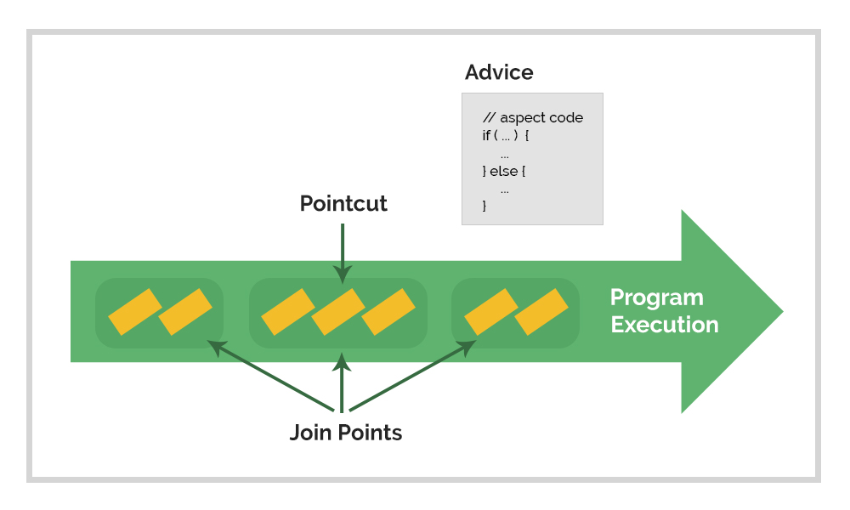
AOP Terminology

Slide 58
Spring AOP
Spring AOP is the Spring Module that helps us implement AOP concepts in our project.
Spring AspectJ AOP implementation provides many annotations:
@Aspect: Declares the class as an Aspect.
@Pointcut: Declares the pointcut expression.
The annotations used to create “advices” are given below:
@Before: Declares a “before advice”. It is applied before calling the actual method.
@After: Declares an “after advice”. It is applied after calling the actual method and before returning the result.
@AfterReturning: Declares an “after returning advice”. It is applied after calling the actual method and before returning the result. You can get the result’s value in the advice.
@Around: Declares an “around advice”. It is applied before and after calling the actual method.
@AfterThrowing: Declares a “throws advice”. It is applied if the actual method throws an exception.

Slide 59
Agenda
Web Services Definition
SOAP Web Services
Definition
WSDL
Advantages
Restful Web Services
Definition
JSON

Slide 60
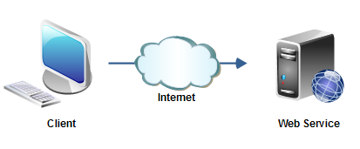
Web Services
It is a service offered by a computer to another computer used to transfer information over the network.
The information can be transferred in XML or JSON data formats.

Slide 61
Communication
It is a service offered by a computer to another computer used to transfer information over the network.
The information can be transferred in XML or JSON data formats.

Slide 62
SOAP
It stands for Simple Object Access Protocol.
It is a messaging protocol specification for exchanging structured information in the implementation of web services in computer networks.
It transfers XML data as SOAP Messages. Each message has something that is known as an XML document.

Slide 63
WSDL
It stands for Web Services Description Language.
The WSDL file is an XML-based file that tells the client application what the web service does.
The WSDL document tells the client application where the web service resides and how to use it.
Notes:
We can use SOAP UI to test SOAP WebServices.
The following is a free webservice that returns information from a German bank by passing the BLZ bank code.
WSDL URL: http://www.thomas-bayer.com/axis2/services/BLZService?wsdl
To get BLZ codes go to: https://www.thebankcodes.com/blz/ Or try for example: 70230000

Slide 64
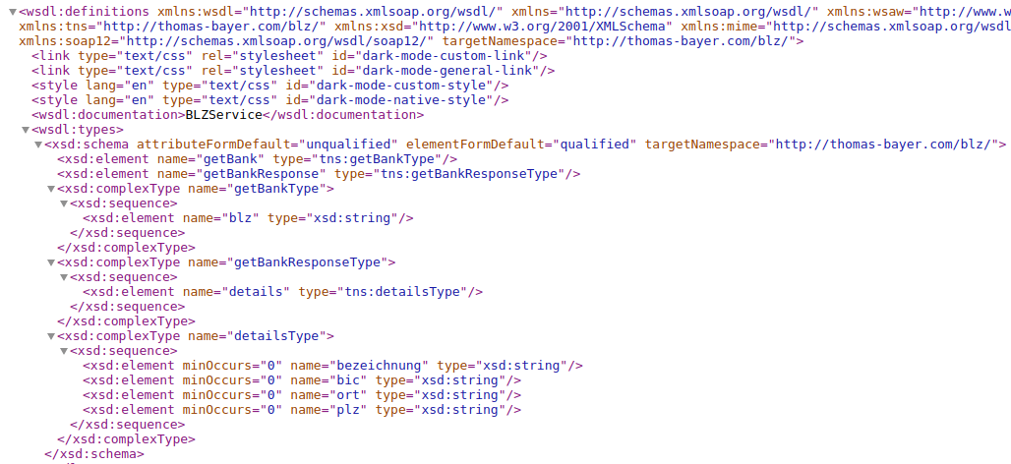
WSDL Example
Notes:
We can use SOAP UI to test SOAP WebServices.
The following is a free webservice that returns information from a German bank by passing the BLZ bank code.
WSDL URL: http://www.thomas-bayer.com/axis2/services/BLZService?wsdl
To get BLZ codes go to: https://www.thebankcodes.com/blz/ Or try for example: 70230000

Slide 65
SOAP Advantages
Exposing Business Functionality on the network - A web service is a managed code unit that provides client applications or end-users functionality.
Interoperability among applications - Web services allow various applications to talk to each other and share data and services among themselves.
A Standardized Protocol, which everybody understands - Web services use standardized industry protocol for communication.
Reduction in cost of communication - Web services use SOAP over HTTP protocol, so you can use your existing low-cost internet for implementing web services.

Slide 66
RESTful
REST is a software architecture that stands for REpresentational State Transfer.
It helps to build lightweight, maintainable, and scalable Web Services.
REST sends information in multiple standards, such as JSON and XML.
A service built on the REST architecture is called a RESTful service. The underlying protocol for REST is HTTP, which is the primary web protocol.
Notes:
We can use Postman to test Rest WebServices.
The following REST endpoint gets the information of the Tourist with id=14841
http://restapi.adequateshop.com/api/Tourist/14841
Routes vs Endpoints
*********************
Endpoints are functions available through the API. This can be things like retrieving the API index, updating a post, or deleting a comment. Endpoints perform a specific function, taking some number of parameters and return data to the client.
A route is the “name” you use to access endpoints, used in the URL. A route can have multiple endpoints associated with it, and which is used depends on the HTTP verb.
For example, with the URL `http://example.com/wp-json/wp/v2/posts/123`:
The “route” is wp/v2/posts/123 – The route doesn’t include wp-json because wp-json is the base path for the API itself.
This route has 3 endpoints:
GET triggers a get_item method, returning the post data to the client.
PUT triggers an update_item method, taking the data to update, and returning the updated post data.
DELETE triggers a delete_item method, returning the now-deleted post data to the client.

Slide 67
JSON
JSON stands for JavaScript Object Notation.
It is a lightweight and minimal data format used for storing and transporting data.
It is often used to send data from a server to a web page or application. The fundamentals of the format are easy to understand.
JSON is a text-only format and can be written in any programming language. JSON data is written in key-value pairs that consist of a field name (in double quotes), followed by a colon, followed by a value.
For example:
"firstName":"Kathy"

Slide 68
JSON
JSON Object:
JSON Array:
It is a collection of key-value pairs. The key-value pairs are written inside curly braces. For example,
{"firstName":"Kathy","lastName":"Harris"}
It is a collection of associative JSON objects contained inside of square brackets. "employees":[ {"firstName":"Kathy", "lastName":"Harris"},
{"firstName":"James", "lastName":"Smith"},
{"firstName":"Mary", "lastName":"Jones"} ]

Slide 69
JSON vs XML
Java Data Structures:
public class Employee{
String firstName;
String lastName;
}
List<Employee> employees = new ArrayList<>();
XML Format:
<employees> <employee> <firstName>John</firstName>
<lastName>Doe</lastName> </employee> <employee> <firstName>Anna</firstName>
<lastName>Smith</lastName> </employee> <employee> <firstName>Peter</firstName>
<lastName>Jones</lastName> </employee> </employees>
JSON Format:
{"employees":[ { "firstName":"John", "lastName":"Doe" }, { "firstName":"Anna", "lastName":"Smith" }, { "firstName":"Peter", "lastName":"Jones" } ]}

Slide 70
JSON vs XML
JSON is better than XML because,
XML is much more difficult to parse than JSON.
JSON is parsed into a ready-to-use JavaScript object.
JSON doesn't use an end tag.
JSON is shorter.
JSON is quicker to read and write.
JSON can use arrays.

Slide 71

Any Questions

